Slide 1
Trench Warfare
Disasters and Diseases
http://www.firstworldwar.com/features/trenchlife.htm

Slide 2
Sleeping where?
How to build them

Slide 3
More ways to build from a French hand book.

Slide 4
Soldiers fought from within the trenches
It was usually tight quarters

Slide 5
Trenches were used by both the Allies and the Central Powers
An aerial photograph of the trenches
First line of defense

Slide 6
In the trenches
Not all trenches were deep.
Many nations fought together

Slide 7
Fighting
Sometimes an easy target

Slide 8
Dangers of Trench life

Slide 9
Trenchfoot
From having wet feet most of the time and nowhere to dry them out

Slide 10
Dead bodies….
Left to rot in the trenches because of the machine gun fire that kept the soldiers in the trenches
An easy food source for rats and a place to breed disease

Slide 11
Bring rats

Slide 12
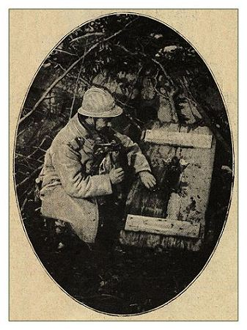
Soldiers of all nations hunted the rats– sometimes rations were short and meat was added to their diet

Slide 13
Christmas truce

Slide 14
Poison Gas
A new weapon, hard to combat. Different gas mask styles were created by different countries. None were 100% effective.

Slide 15
Belgian Uniforms and masks
Australian Gas mask

Slide 16
Japanese gas mask
U. S. gas mask

Slide 17
Gas Training

Slide 18
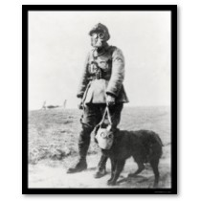
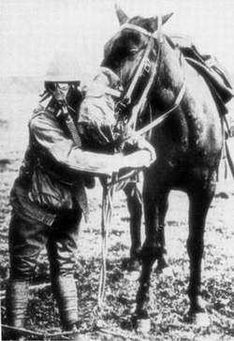
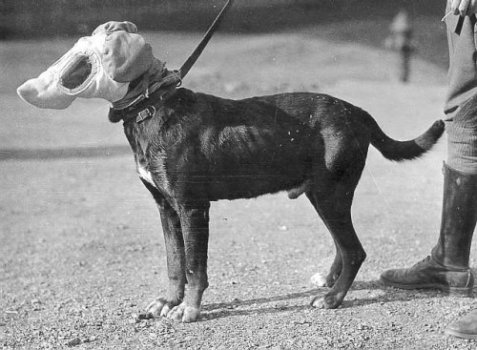

Slide 19
Poetry and Literature of World War I
Extra Credit is available

Slide 20
Dulce Et Decorum Est
Bent double, like old beggars under sacks, Knock-kneed, coughing like hags, we cursed through sludge, Till on the haunting flares we turned our backs And towards our distant rest began to trudge. Men marched asleep. Many had lost their boots But limped on, blood-shod. All went lame; all blind; Drunk with fatigue; deaf even to the hoots Of disappointed shells that dropped behind. GAS! Gas! Quick, boys!-- An ecstasy of fumbling, Fitting the clumsy helmets just in time; But someone still was yelling out and stumbling And floundering like a man in fire or lime.-- Dim, through the misty panes and thick green light As under a green sea, I saw him drowning.

Slide 21
* It is sweet and proper to die for your country Wilfred Owen, died 1918
In all my dreams, before my helpless sight, He plunges at me, guttering, choking, drowning. If in some smothering dreams you too could pace Behind the wagon that we flung him in, And watch the white eyes writhing in his face, His hanging face, like a devil's sick of sin; If you could hear, at every jolt, the blood Come gargling from the froth-corrupted lungs, Obscene as cancer, bitter as the cud Of vile, incurable sores on innocent tongues,-- My friend, you would not tell with such high zest To children ardent for some desperate glory, The old Lie: Dulce et decorum est Pro patria mori. *

Slide 22
Louse Hunting
Nudes -- stark and glistening, Yelling in lurid glee. Grinning faces And raging limbs Whirl over the floor one fire. For a shirt verminously busy Yon soldier tore from his throat, with oaths Godhead might shrink at, but not the lice. And soon the shirt was aflare Over the candle he'd lit while we lay.
Then we all sprang up and stript To hunt the verminous brood. Soon like a demons' pantomine The place was raging.

Slide 23
What a louse looks like if it were large enough to see.

Slide 24
See the silhouettes agape, See the glibbering shadows Mixed with the battled arms on the wall. See gargantuan hooked fingers Pluck in supreme flesh To smutch supreme littleness. See the merry limbs in hot Highland fling Because some wizard vermin Charmed from the quiet this revel When our ears were half lulled By the dark music Blown from Sleep's trumpet
Isaac Rosenberg

Slide 25
In Flanders Fields
In Flanders fields the poppies blow Between the crosses, row on row That mark our place; and in the sky The larks, still bravely singing, fly Scarce heard amid the guns below. We are the Dead. Short days ago We lived, felt dawn, saw sunset glow, Loved and were loved, and now we lie In Flanders fields. Take up our quarrel with the foe: To you from failing hands we throw The torch; be yours to hold it high. If ye break faith with us who die We shall not sleep, though poppies grow In Flanders fields.
John McCrae, died 1918

Slide 26
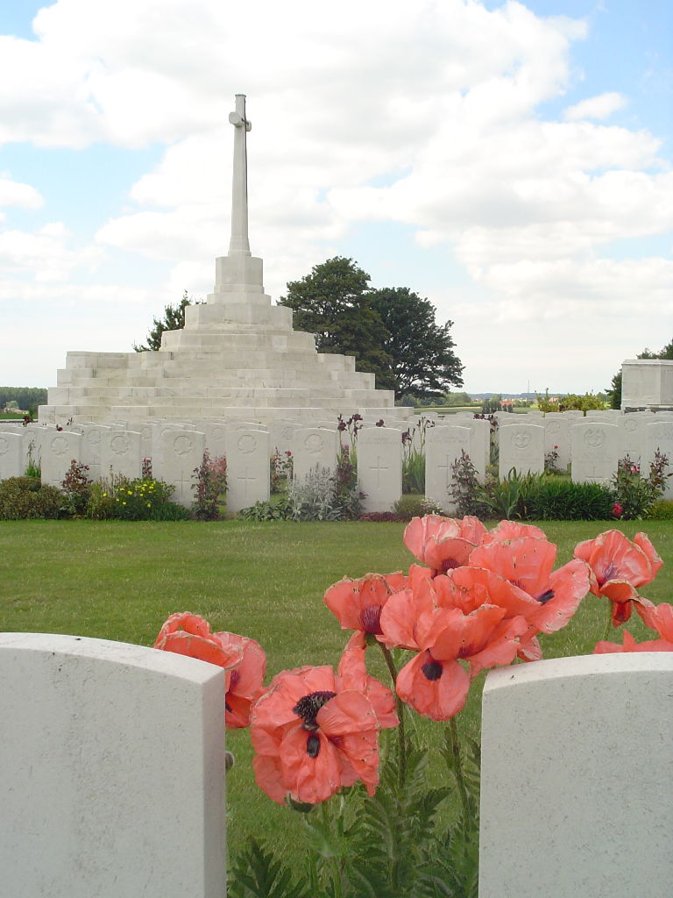
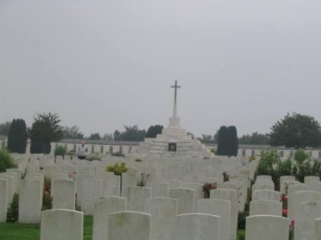

Slide 27
More resources on page 986 of the text. Possible extra credit test score
Write a poem as if you were a soldier or a medic during World War I, living and working in the trenches. It must be at least 12 lines and actually be decent.

Slide 28
This powerpoint was kindly donated to
www.worldofteaching.com
http://www.worldofteaching.com
Is home to well over a thousand powerpoints submitted by teachers. This a free site. Please visit and I hope it will help in your teaching
Notes:
28

